Slide 1
Children and the psychic sufferings
By Jean-Luc Vannier,
Psychoanalyst, assistant Professor at Nice Côte d’Azur University & Pr. at Edhec and Ipag P.G. Business School, Nice, French Riviera, France

Slide 2
Children and the psychic sufferings
My 7-year-old goddaughter came last summer to visit me with her mother. While I am talking with her mother, she discovers on my desk a file composed of drawings made during consultations with children. Her cheerful face suddenly becomes serious, almost as serious as if she directly understood, without the mediation of speech, the interrogations, even the sufferings expressed by these little colored sketches. It seems easy for her to decipher an accessible message.
One must be wary of the etymology. Even if the child comes from “infans” (who does not speak, who does not understand the language of the adult), the little ones always find a way to express themselves especially when the psychic pain assails them. And for a good reason: no more time for surgical operations without anesthesia in the baby. The perception of pain is scientifically attested from the 24th week of intrauterine life.

Slide 3
Children and the psychic sufferings
In the event of a physical accident, this pain is visible: a radiograph reveals a fracture, an examination with the naked eye shows a hematoma, the child indicates with his awkward gestures the location of “where it hurts”.
What about the psychic pain, the one whose parents do not perceive existence, still less the intensity? In these few lines we propose to provide some examples through consultations with young children in the context of divorce, often with violence. These interviews took place at the request of one of the parents' lawyers. With the consent of the accompanying parent, I always write a full verbatim of the session, enclosing the drawings if possible.
-1st case - Nathalie takes it “full on her head”

Slide 4
Children and the psychic sufferings

Slide 5
Children and the psychic sufferings
Aged 5, little Nathalie witnessed a scene of a rare violence between her mother and her younger companion. Drunk and after smoking cannabis, the man, in a dispute of which the little girl is the witness, insults the mother and then blows her, leaving her unconscious on the ground. Warned by the neighbors, the firemen and the police intervene, always under the gaze of Nathalie who becomes mute. Two weeks later, not satisfied with an improvement in the language of the child, the grand-parents decided, on the advice of the daughter's lawyer, to consult me in order to produce an expertise for the court.
After the mother explains the whole story, under the watchful eye of Nathalie, I invite the little girl to follow me into the clinic room to draw. She takes the A4 white sheet of paper and in a corner of it draws an enormous head neglecting the other parts of the body. In addition, she “frames” her drawing by an interior line. We interpret: “your head is full”. She nods silently. We continue: “There must be a lot in this head to make it so big.” She opines. We add: “If you tell me what is in your head, it will become smaller again.” The child sheds a few tears and said, “I can not, it's too hard.”

Slide 6
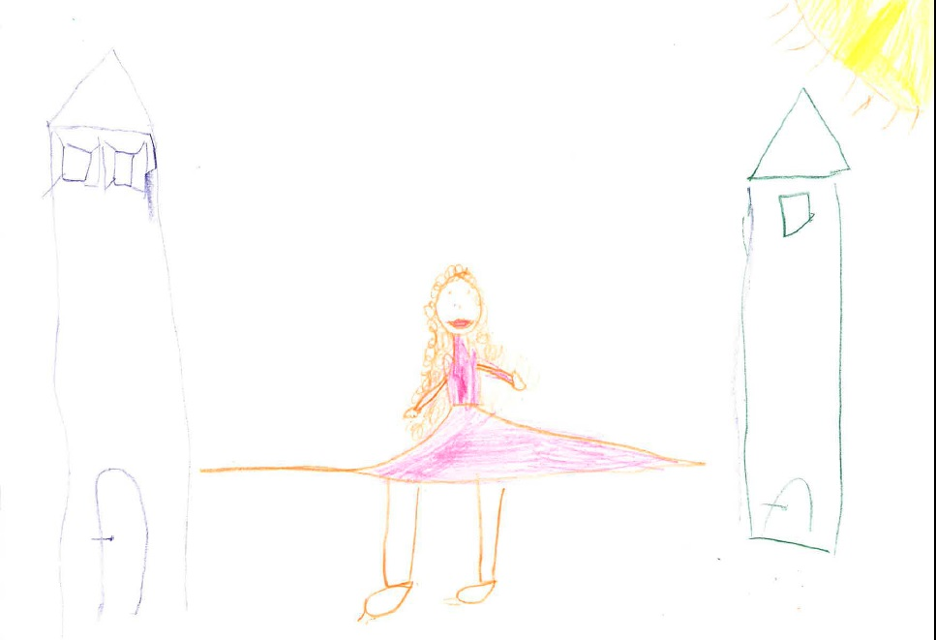
Children and the psychic sufferings
-2nd Case- “I do not like to choose between mom and dad”

Slide 7
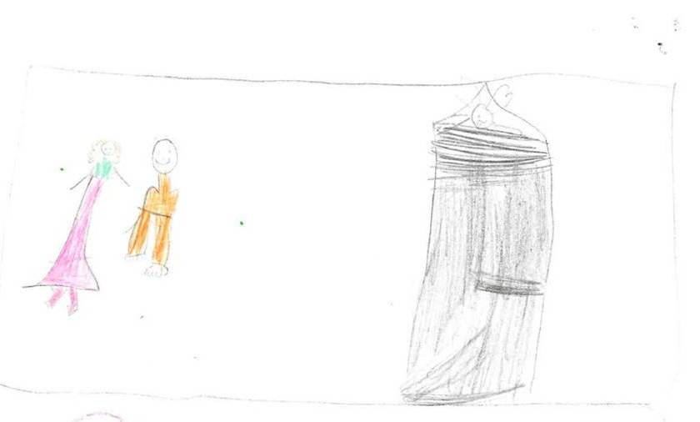
Children and the psychic sufferings
3rd Case: “I do not like black and white”
“My brain is irritated” she said, taking her small head between her two clenched fists, “because he would like me to understand”.
“I can not express myself not because I do not have the vocabulary
but because
the subject
is difficult.
Too difficult”.

Slide 8
Children and the psychic sufferings
4th case: “The happy family: the colors of the life's drive”
The needs for a stable and a durable familial organization
The rôles, the places and the creative nicknames within the familial constellation

Slide 9
Children and the psychic sufferings

Slide 10
Children and the psychic sufferings
5th case: the compulsive & repetitive disorder of the mother
The discovery during the session that her brother is only her half-brother (following an interpellation of the little girl during the anamnestic narrative of her history by the mother: “you forget someone”.
She rushed upon her brother. I must point out -I have also remarked to the mother- the intensity of the emotional and tactile symbiosis that was formed between the sister and her half-brother. From the beginning of the consultation, even during the mother's explanations, and after the execution of the drawings, both children seemed unable to do without each other: tender looks, prolonged embraces, soft kisses and accomplice games punctuated a relationship which seemed to compensate for the failing one of the adults. This appears to be an usual phenomenon of the protective bubble or that of a restorative during the difficult separations. Obviously, these children have recreated a family unit between themselves.

Slide 11
Children and the psychic sufferings

Slide 12
Children and the psychic sufferings
Many clinic elements to observe and to elaborate on:
-The ambivalence of the mistreated child (See also Marina’s case)
-The definition of the psychic trauma & the “afterwardsness” effect.
-The anxiety as a result of the inadequacy between the somatic excitation and the psychic ability to elaborate it (Freud)
-The childish fundamental fear of being abandoned (See also the keychain of Norman's father case): “Hilflosigkeit” (Freud)
-The difficulty to assess and to find out the truth: between sexual seduction and sexual fantasy (Freud, Laplanche)
-The responsibility of the psychoanalyst vis-à-vis the legal investigation.
-The asymmetric relationship between the child and the grown up (Laplanche and “the fundamental anthropological situation”).

Slide 13
Children and the psychic sufferings

Slide 14
Children and the psychic sufferings
Bibliography
Alain Braconnier & Bernard Golse (Sous la direction de), Dépression du bébé, dépression de l’adolescent, Erès, Le Carnet Psy, 2010.
Sigmund Freud, « Trois essais sur la théorie sexuelle », Œuvres Complètes, VI, 1901-1905, PUF, 2009.
Claudine Geissmann & Didier Houzel (Sous la direction de) , L’enfant, ses parents et le psychanalyste, Bayard, Coll. « Compact », 2000.
Laurence Kahn, Cures d’enfance, Gallimard, NRF, 2004.
Mélanie Klein, La psychanalyse des enfants, PUF, 1993.
Jean Laplanche, « Le crime sexuel » et « Le genre, le sexe, le sexual », Sexual, La sexualité élargie au sens freudien, 2000-2006, PUF, Coll. « Quadrige », 2007.
Otto Rank, Le traumatisme de la naissance, Petite Bibliothèque Payot, 2002.
Serge Tisseron, Les secrets de famille, Que sais-je?, PUF, 2ème édition 2017.
Denis Vasse, La grande menace, La psychanalyse et l’enfant, Seuil, 2004.
Daniel Widlöcher & Jean Laplanche, Sexualité infantile et attachement, PUF, 2000.
Donald W. Winnicott, La nature humaine, Gallimard, Coll. « Tel », 1990.

Slide 15
Children and the psychic sufferings
Thanks for your kind attention
vannier06@gmail.com
00 33 6 16 52 55 20

