Slide 1
In the name of Allah
The Most Gracious and The Most Merciful

Slide 2
Key note SPEAKER Assoc. Prof Dr. Siti Aishah Hassan for International Conference on Culture, Psychopathology and Education Tehran 3-4 May , 2017

Slide 3
Rasch Model Analysis on Malay Love Song Lyrics And Its Relationship with Willingness for Counseling Help Seeking
ASSOC. PROF. DR. SITI AISHAH HASSAN
Department of Counselor Education and Counseling Psychology
Faculty of Educational Studies
University Putra Malaysia
Top 200 QS World University Subject Ranking

Slide 4
PRESENTATION PREVIEW
Introduction
Problem Statement
Research Objective
Islamic Hierarchy of Love
Methodology
Results
Discussion

Slide 5
INTRODUCTION
The word love attracts not only the young and the restless but also the matured and the established (Hassan et al. 2009)
Empirical studies consistently indicate love is the most prevalence reason for couple to get married (Sprecher & Hatfield, 2015).
Yet, love may not be the reason for a long lasting marriage.
Hence, love remains as a puzzle.

Slide 6
INTRODUCTION
Song and culture are inseparable .
Popular lyrics songs serve as a window in understanding the psychology of certain population.
Today, in this keynote speech, we would to share a Rasch Model Analysis on Malay love song lyrics
Hopefully, we know each other better

Slide 7
Al-Hujurat Verse 13

Slide 8
PROBLEM STATEMENT
The word love has semantic problem for English-speaking people (“Treating Couples in Crisis” by Robert L. Baker ,1984).
Falling in love and making love are two different meanings of love.
Love between parents and children are different with love between husband and wife.
Love for money is different with love for knowledge.
Thus, we suggest word love should be replaced by dozens of totally different words.

Slide 9
PROBLEM STATEMENT
Studies provide evidence that song lyrics is a powerful influential factor on emotion, thought and behavior (Pond et al, 2011).
In the battle field we need song to help us to more forceful in fighting, so does in marital life.
Marriage is a battle field to fight against social illness.
Hence, understanding love song lyrics is pertinent to help couples.

Slide 10
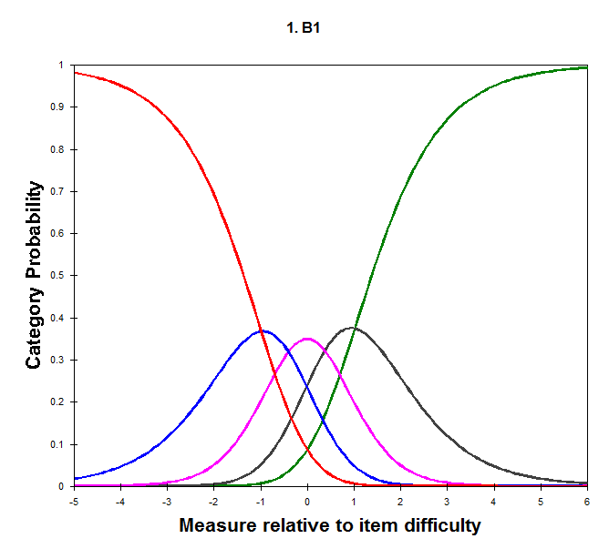
OBJECTIVE
To report Rasch model analysis on Malay song lyrics against a theoretical construct known as hierarchy of love in human relations
To investigate the relationship of the response on Malay love song lyrics and willingness for counselling help seeking.

Slide 11
Love in Arabic and Quranic Language
Al-Ghazali (505 H) define love as the inclination of nature to something that is
pleasure giving, warm, attachment, affection, regard, devotion and yearning.
Love, according to the Islamic worldwide, originates from the spirit of Allah that was breathed into Adam and subsequently passed down to his descendants.
This spirit carried with it the 99 attributes that Allah has declared for Himself, which include among others the attributes of the All-Gracious (al-Rahman), the Very Merciful (al-Raheem)

Slide 12
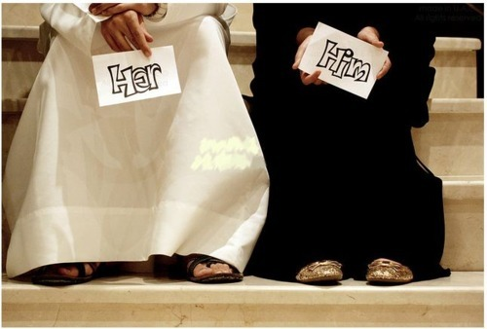
Love in Arabic and Quranic Language
The root mahabba and related derivatives such as hub and muhabbah.
Wadda and its related derivaties such as wud and mawaddah, isyq, huyam, syaghaf, and khullah.
The words wud and mawaddah refer to purest, finest and most begin from of love.
The notion of love is also accompanied with the words rahima and rahmah which literally mean mercy and kindness.
The word syagaf which was used in the Quran to describe the Vizier’s wife’s love for Prophet Joseph means love that has penetrated deep beneath the walls of the heart

Slide 13
Love in Arabic Language only
Isyq, according to Ibn Qayyim, is the most awful word for love; it was never mentioned in the Quran and appeared only once in a weakly narrated prophetic tradition.
It refers to excessive love usually accompanied with immorality.

Slide 14
Hierarchy of Love In Human Relations
Red Zone: Dangerous
(Highest Level 1 &2)
Green Zone: Healthy
(Middle Level 3-9)
Yellow Zone: Poor
(Lowest 10-11)

Slide 15
Hierarchy of love

Slide 16
METHODOLOGY
Phase 1
245 respondents were randomly selected from a public university
Phase 2
169 respondents were randomly selected from a public university in Malaysia

Slide 17
METHODOLOGY (Instrumentation)
Malay Love Songs Lyrics (MLSL)
97 items were constructed from 20 Malay love songs prior to year 2000 and after 2000
Willingness Of Counseling Help Seeking (WCHS)
3 items.
Likert-type scale
Likert-type scale

Slide 18
RESULTS
PHASE 1
The person reliability was .96 and the item reliability .85
Dimensionality showed there were two latent construct of MLSL: i) Transcendental love and ii) Natural Love.
Person-Map-Item
- Five level of respondents
- Two level of items
All items were functions the same intended positive direction, where items are unidimensionaly measure the intensity of hierarchy of love (infit, outfit 1.96)

Slide 19
PERSON RELIABILITY AND ITEM RELIABILITY
Figure 1: The person reliability and item reliability

Slide 20
PERSON-MAP-RELIABILITY

Slide 21
CATEGORY PROBABLITY CURVES
Hierarchy of Love

Slide 22
RESULTS
PHASE 2
Pearson correlation MLSL with WCHS
r=.228, p<.05

Slide 23
Discussion & Conclusion
Our findings show that Malay love song lyrics (MLSL) have two dimensions and two levels
The dimensions are natural love and transcendental love
MLSL are spreading into two level in hierarchy of love of human relations.
MLSL are non extreme and most of them located at the healthy love zone
Those who are more affected by love song lyrics are more willing to seek for counselling help.

Slide 24
Practical Implication
Describes your love emotion in many different words besides I love you…
I adore you
I am captivated by you
If you do not have all the vocabulary , the love song lyrics may help you to find words to express your feeling
Counseling clinics may use love songs as the background music to set the mood for clients in seeking help for their marital problems.

Slide 25
A song to remember. . .

Slide 26
Terima Kasih | Thank You

